Slide 1
Minor CapStone Project Presentation(2026)
Project Title-
Circle Up
By - Zoya Khanam
submitted on - 14/07/2026

Slide 2
Content
Introduction
Tech Stack
Features and Functionality
Data Flow Diagram
Architecture Diagram
Entity-Relationship Diagram
Snapshots

Slide 3
Introduction
CircleUp is a full-stack web platform where user can create activities and can discover, filter, and request to join them. The host can approve or reject requests and the capacity is enforced automatically.
Key highlights:
Built for everyone - open discovery, with optional gender-specific activities (all / female_only)
Location, category, and date-based filtering
Safe & authorized - JWT auth, Argon2 password hashing, ownership-based access control

Slide 4
Features and Functionality
Activity Discovery - filter by category, location, date, and gender
Participation Flow - user requests to join → host approves/rejects → status updates (pending/approved/rejected)
Capacity Locking - with_for_update() pessimistic locking prevents overbooking under concurrent requests
Host Dashboard - live pending-request counts, one-click approve/reject
Gender-based Filtering - activities marked all or female_only
Ownership-based Authorization - only the creator can modify/manage their activity
Auth - JWT-based login/signup with Argon2-hashed passwords

Slide 5
Tech Stack
Backend:
FastAPI (Python) — layered architecture: routers → services → repositories
PostgreSQL + SQLAlchemy ORM
Alembic — versioned database migrations
JWT for auth tokens + Argon2 (passlib) for password hashing
Pydantic schemas
Frontend:
Vanilla JavaScript (no framework)
HTML & CSS - Theme - Nunito font, wheat background, pastel green brand color
Fetch API to call backend REST endpoints
Served via FastAPI StaticFiles at localhost:8000

Slide 6
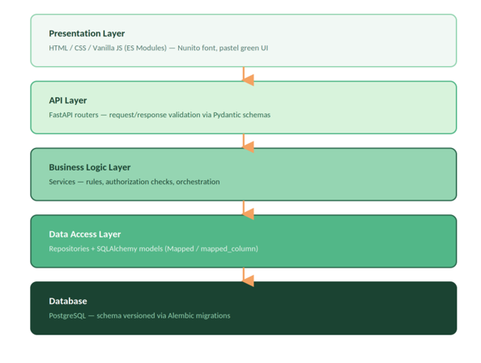
Architecture Diagram

Slide 7
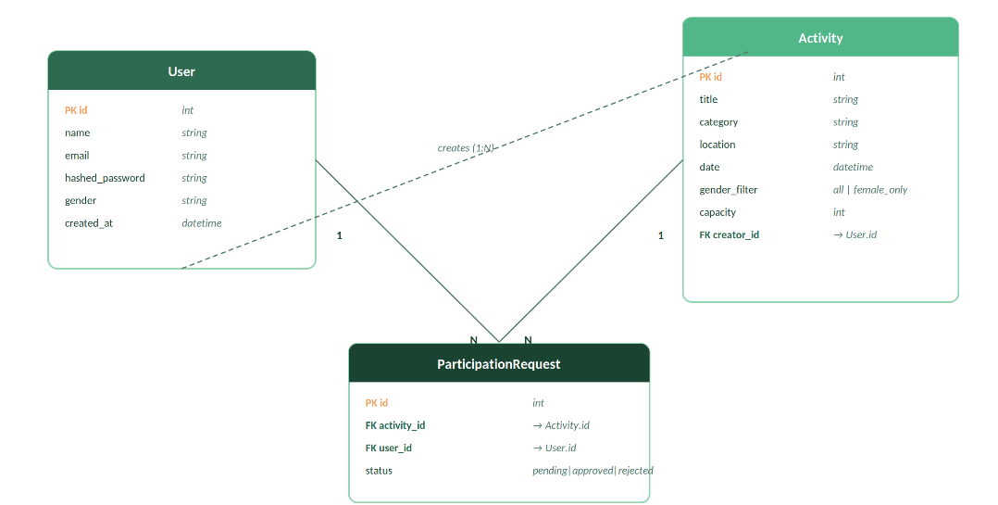
Entity-Relationship Diagram

Slide 8
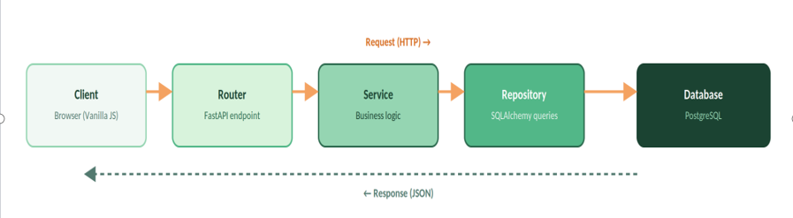
Data Flow Diagram

Slide 9
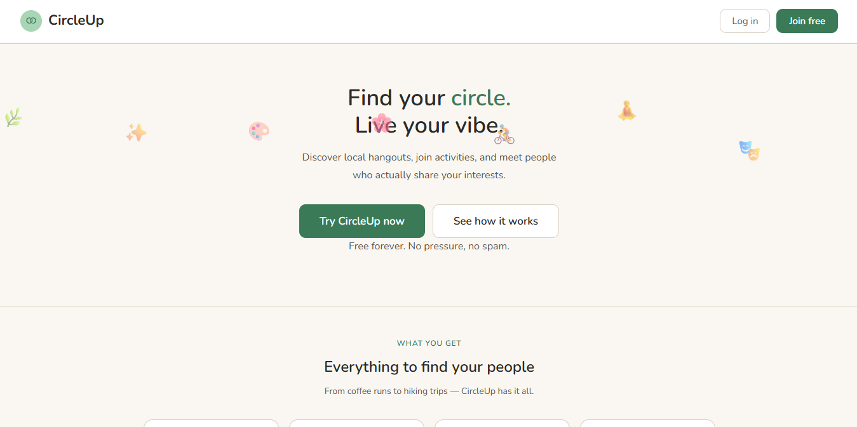
Snapshots - Landing page

Slide 10
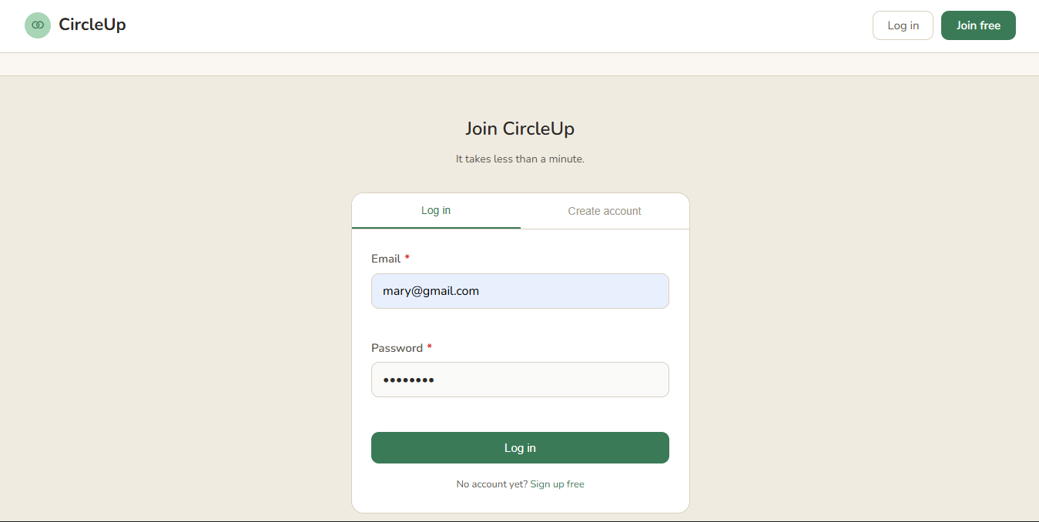
Snapshots- login page

Slide 11
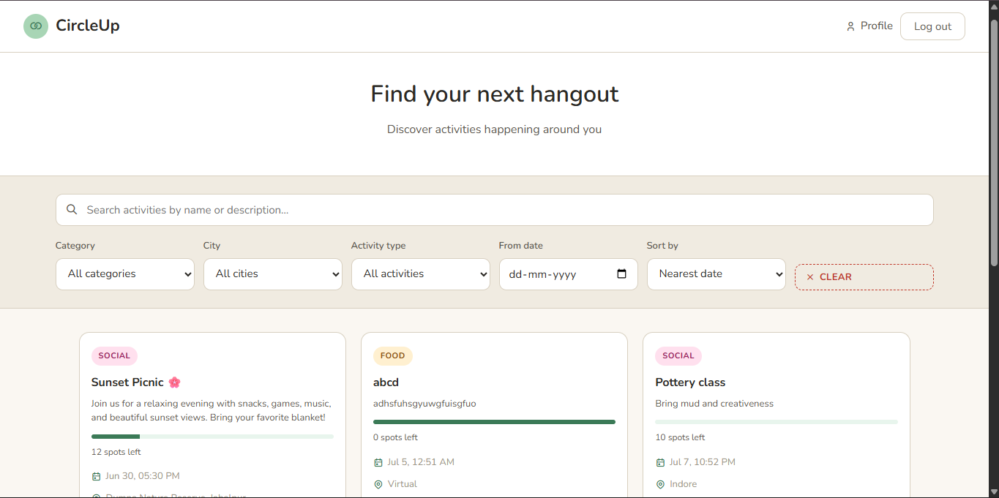
Snapshots- activity discovery page

Slide 12
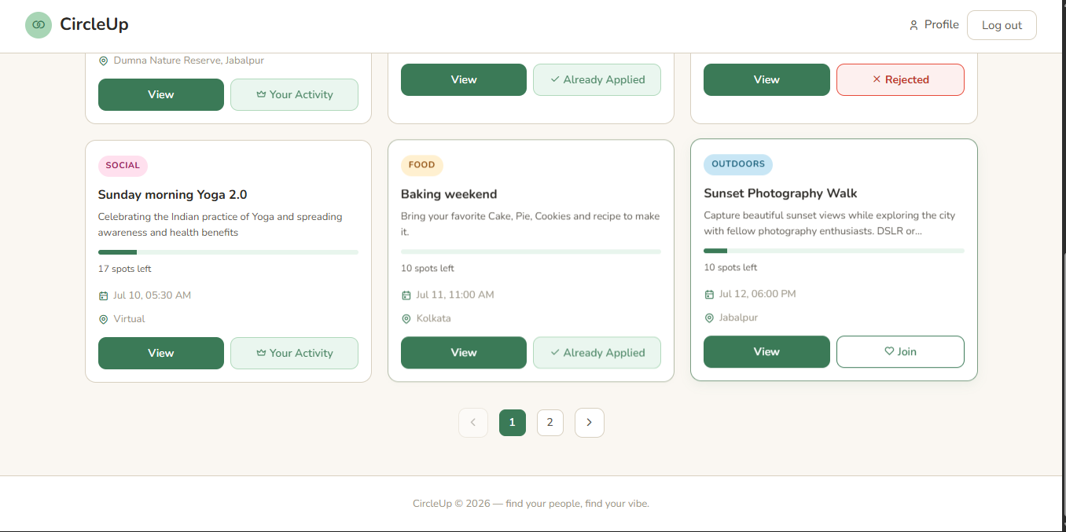
Snapshots- activity discovery page

Slide 13
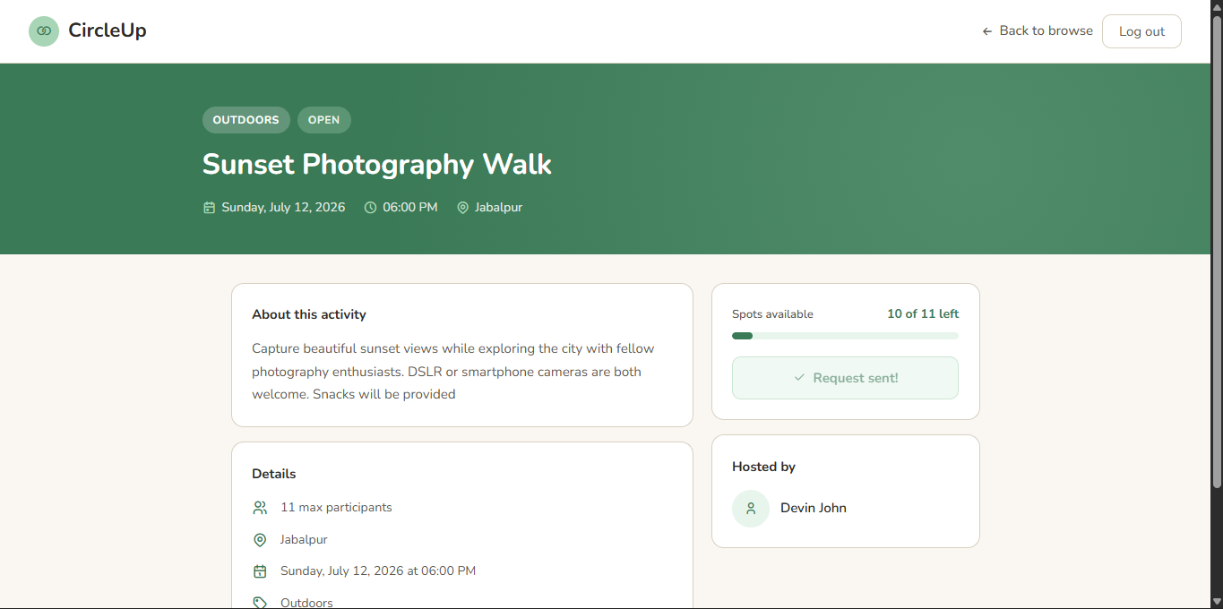
Snapshots- activity details page

Slide 14
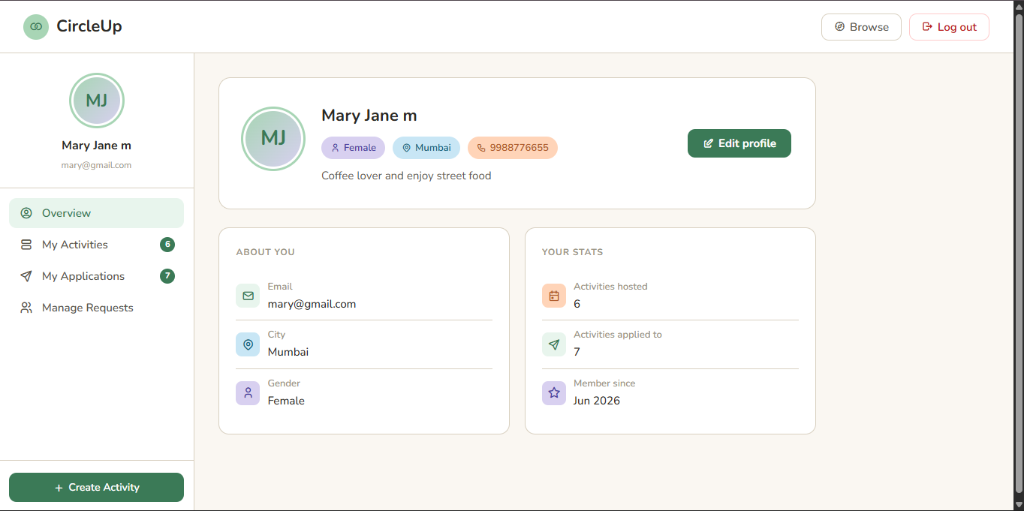
Snapshots- user profile

Slide 15
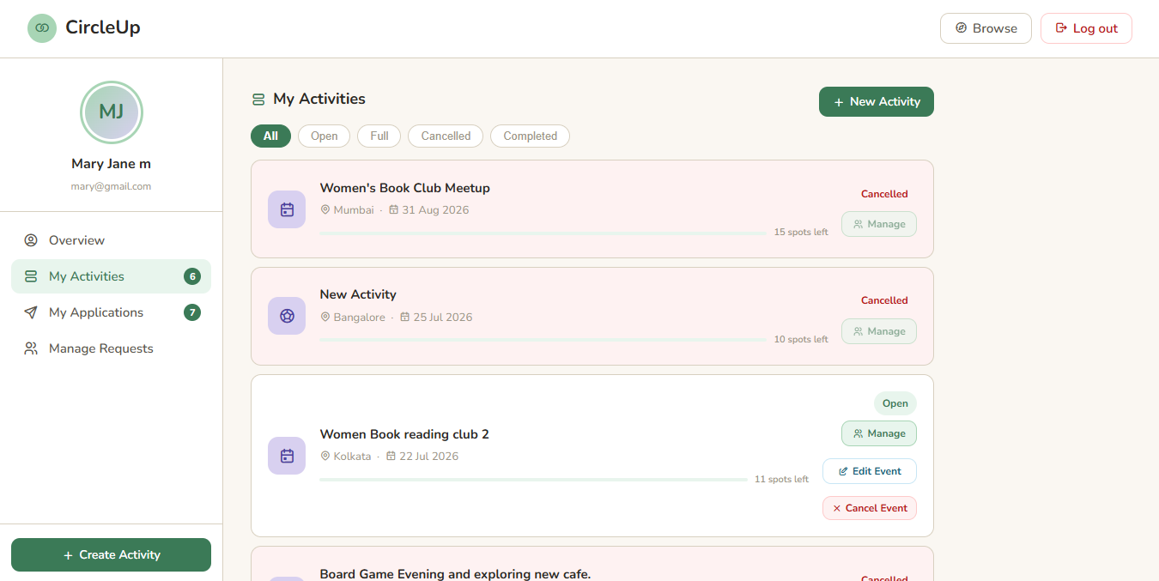
Snapshots- my activities section

Slide 16
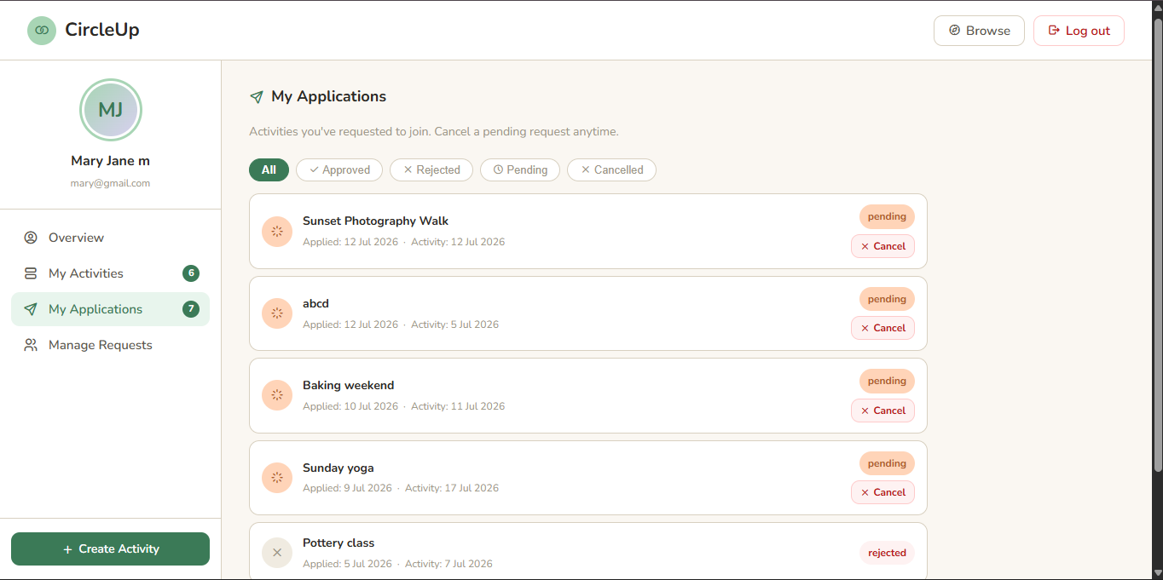
Snapshots- my applications

Slide 17
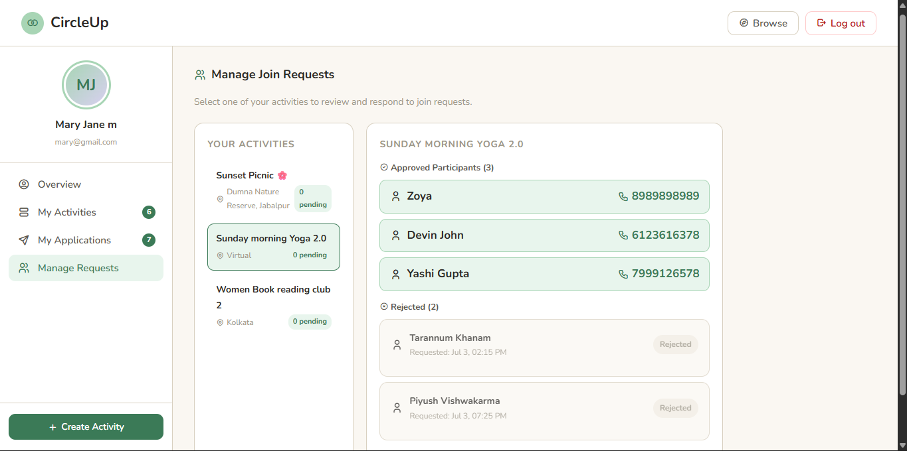
Snapshots- Manage requests section

Slide 18
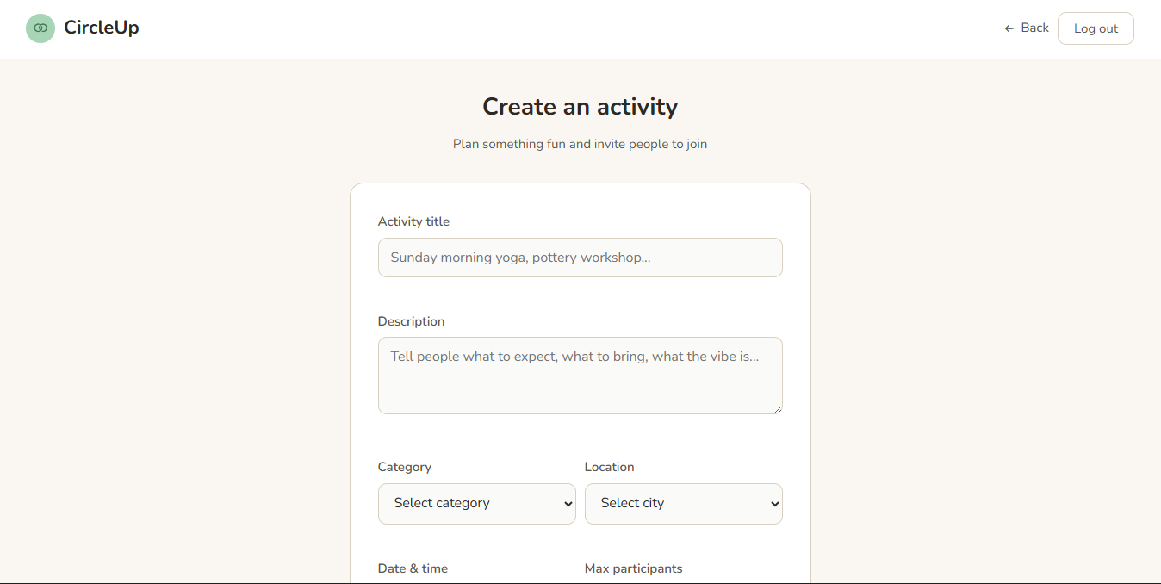
Snapshots- Create activity form

Slide 19
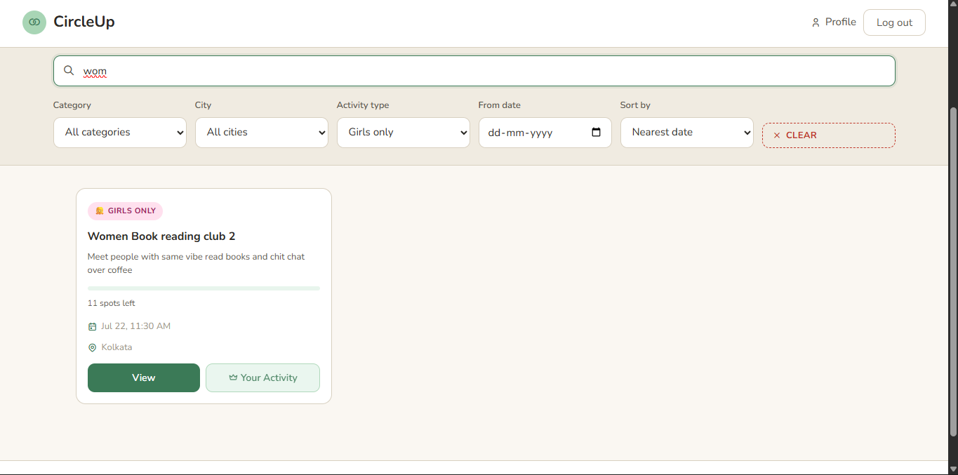
Snapshots- girls only activity (additional feature)

Slide 20
Thank You

